Slide 1


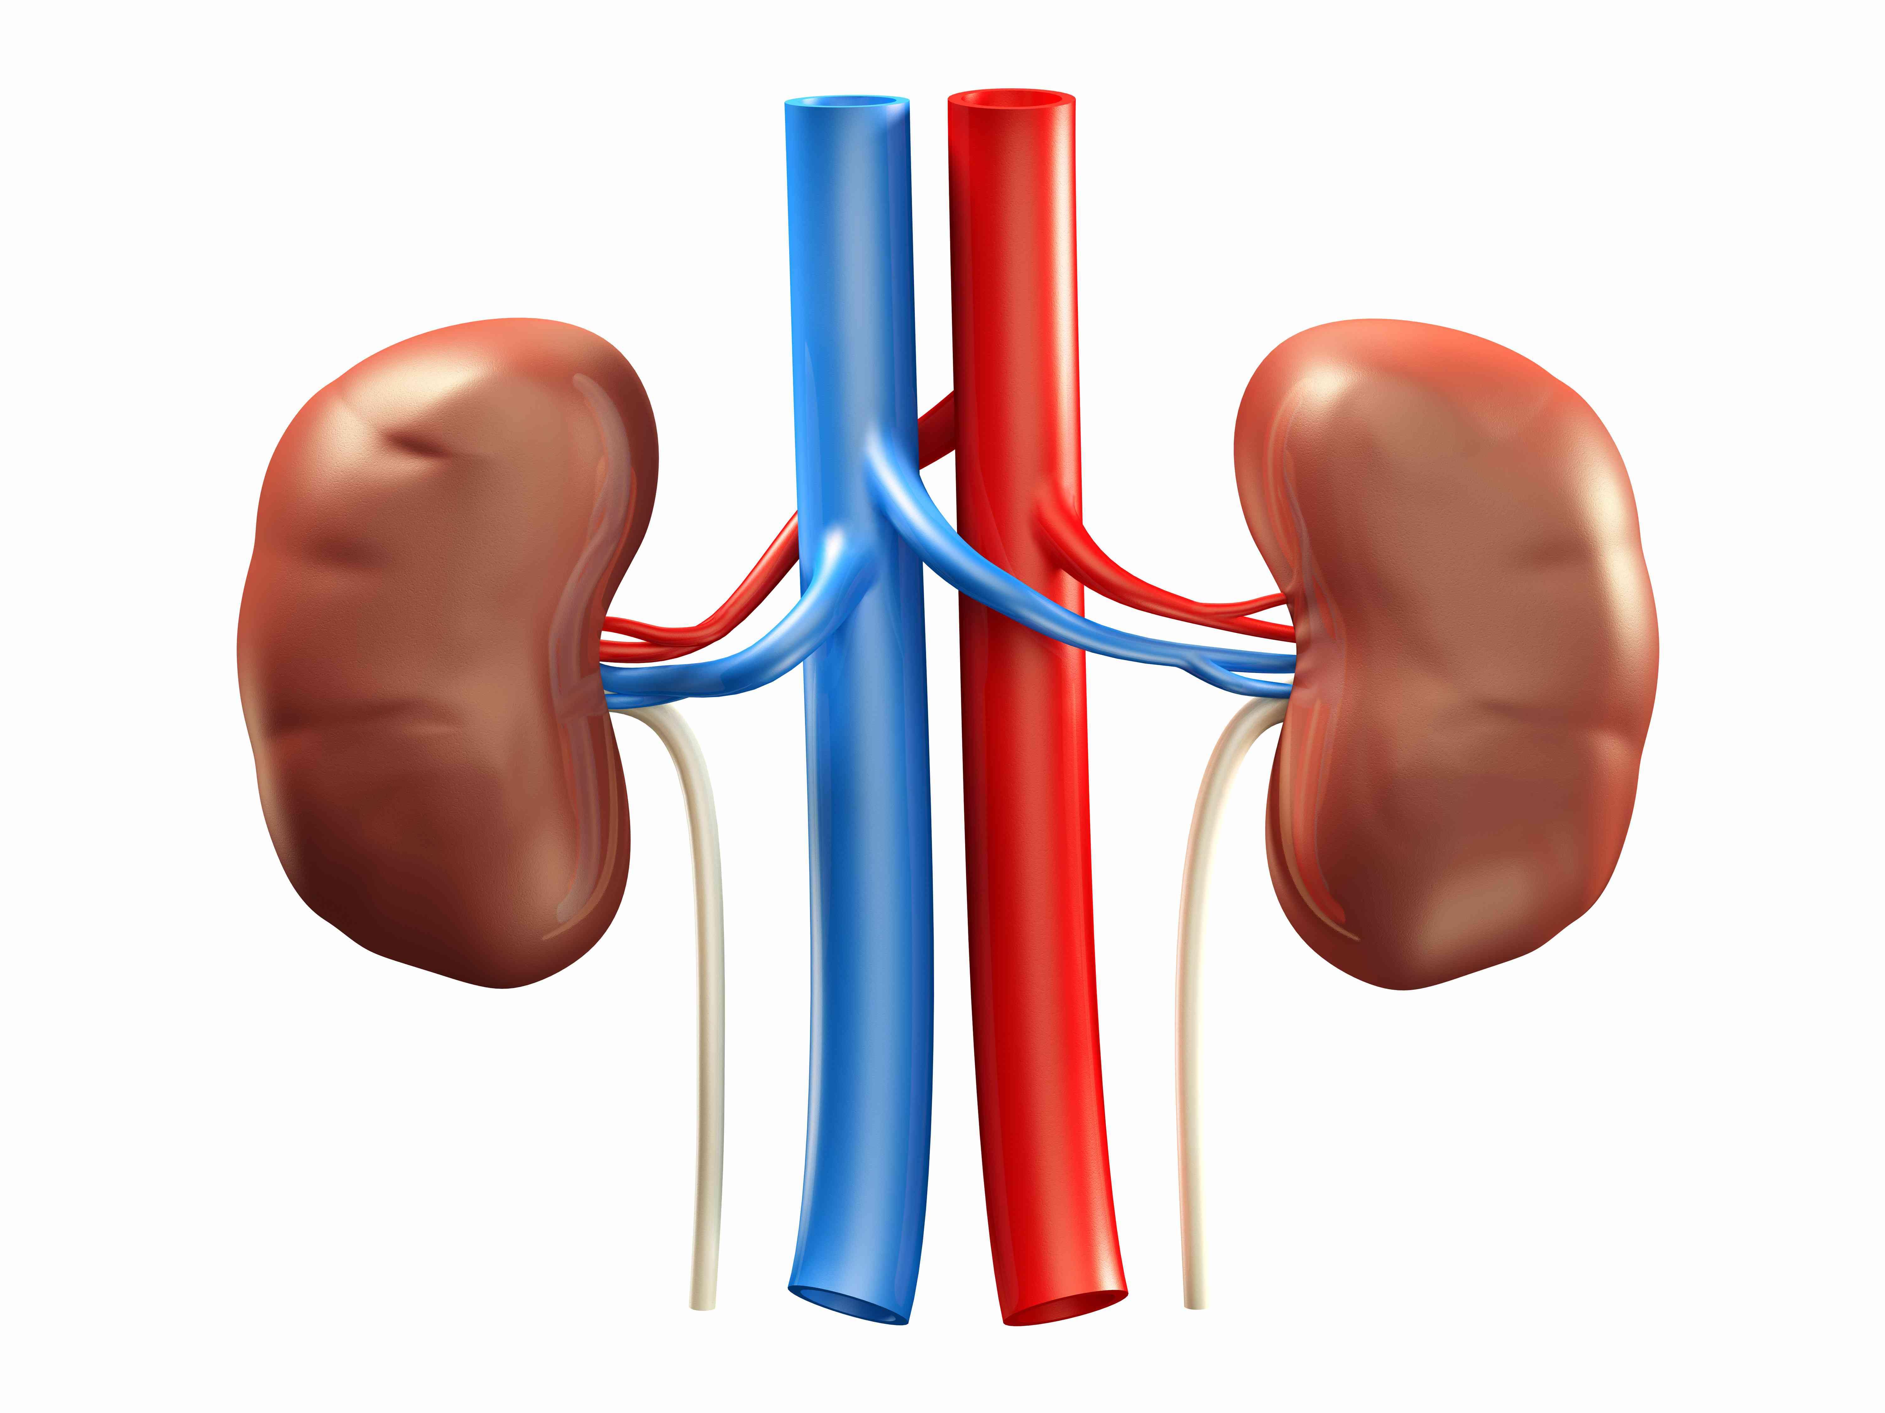
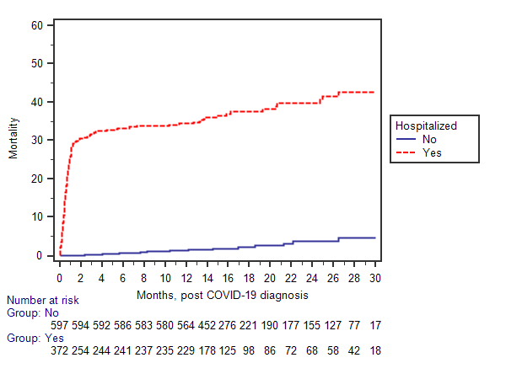


Sequelae of Severe Acute Respiratory Syndrome Coronavirus 2 (SARS-CoV-2) Infection Among Kidney Transplant Recipients: A Large Single Center Experience
¹Emily Zona, BS; ¹Mina L. Gibes, BA; ¹Asha S. Jain, BS; ^{2,3}Juan S. Danobeitia, MD; ³Jacqueline Garonzik Wang, MD, PhD; ⁴Jeannina A. Smith, MD; ¹Didier Mandelbrot, MD; ¹Sandesh Parajuli, MD
¹Department of Nephrology, Department of Medicine, University of Wisconsin School of Medicine and Public Health, Madison, WI
²Annette C. and Harold C. Simmons Transplant Institute, Baylor University Medical Center, Dallas, Texas, USA
³Department of Transplantation, Department of Surgery, University of Wisconsin Hospital and Clinics, Madison, WI
⁴Department of Infectious Disease, University of Wisconsin Hospital and Clinics, Madison, Wisconsin, USA
Introduction
Scan this QR code to access a PDF with all the results tables
  SARS-CoV-2 virus has a disproportionate impact on solid organ transplant recipients (SOTRs), who are at high risk of infection and adverse outcomes including hospitalization, allograft failure, and mortality.
  Early studies in kidney transplant recipients (KTRs) with symptomatic COVID-19 showed a mortality rate of 30%. In a national study of mortality among SOTRs during the COVID-19 era, there were 5083 excess deaths in the United States in the first 13 months of the pandemic, representing 1 in 75 SOTRs, with KTRs having a higher rate of mortality compared to other SOTRs.
  Existing literature on risk factors and outcomes of COVID-19 among KTRs is ambiguous, inconsistent, or contradictory.
  Advanced age is a widely-documented factor in determining the risk of severe disease and mortality.
A
p<0.001
Summary of Risk Factors & Protective Factors
According to Multivariate Analyses
 | Hospitalization | All-Cause Mortality | COVID-Related Mortality
Risk Factors | Advanced age Male sex Nonwhite race Diabetes as cause of ESKD Lower baseline eGFR pre-SARS-CoV-2 infection | Advanced age Nonwhite race Diabetes as cause of ESKD Lower baseline eGFR pre-SARS-Co—2 infection Longer interval from transplant to SARS-CoV-2 infection Hospitalization Respiratory symptoms for hospital admission | Advanced age Longer interval from transplant to SARS-CoV-2 infection Hospitalization Respiratory symptoms for hospital admission
Protective Factors | Vaccination | Vaccination Living donor recipient | Vaccination
Figure 1. All-Cause Mortality
  This study investigates risk factors and outcomes associated with hospitalization and mortality in kidney-only transplant recipients at our center within the first two years of COVID-19 pandemic and at least one year of follow-up.
Discussion
Most of the risk factors for hospitalization, overall mortality, and COVID-19-related mortality in our cohort were non-modifiable.
This study is consistent with previous studies of the protective effect of vaccination in solid organ transplant recipients. In our study, receiving at least 1 dose of the available COVID-19 vaccine had a protective effect on hospitalization, overall mortality, and COVID-19 related mortality.
Although the literature shows that immunological responses to COVID-19 vaccines are lower in solid organ transplant recipients compared to the general population, vaccination is effective in preventing critical outcomes including ICU admission and death.
These data reiterate the importance of COVID-19 vaccine uptake among kidney transplant recipients, individuals who are vulnerable to the negative impact of the disease.
Methods
Single-center study of kidney-only transplant recipients at the University of Wisconsin with longitudinal follow-up in our outpatient transplant clinic who were subsequently diagnosed with SARS-CoV-2 virus infection between April 2020 and April 2022.
Exclusion criteria included multi-organ transplant recipients and recipients <18 years old at the time of COVID-19 diagnosis
Recipients were divided into two groups based on whether they were hospitalized within the first 10 days of the diagnosis of SARS-CoV-2 infection or not
Results
Of the 979 KTRs, 381 (39%) required hospitalization, whereas 598 (61%) were treated in the outpatient setting.
The most common indication for hospitalization was COVID-19-related respiratory symptoms, found in 285 (75%) of hospitalized recipients. 88 (23%) were admitted to an ICU.
Graft function was inferior among the hospitalized group, from the baseline to the last follow-up. At last follow-up, 205 recipients (21%) experienced graft failures, of which 156 (16%) resulted in death. Notably, 119 (12%) of these deaths were primarily attributed to COVID-19, with the majority occurring in the hospitalized group.
Non-Hospitalized (n=598), 61% | Hospitalized (n=381), 39%
Notes:
Lichen sclerosus is a idiopathic chronic inflammatory disease of the genital epithelium which is associated with severe urethral stricture disease in affected men. Decreased expression of the cell surface receptor CD44 results in altered tight junctions and increased epithelial permeability. We propose that impaired epithelial barrier function may drive chronic inflammation in LS through increased exposure to immunogenic substances. Therefore, we hypothesize that CD44 expression is decreased in in human LS tissues compared to non-LS tissues. We tested this hypothesis using a case-control design reviewing available vulvar, urethral, and foreskin tissues with a genitourinary pathologist determine LS status. We analyzed 29 LS and 23 non-ls tissues comparing the mean optical density of CD44 immunohistochemical staining in the epithelium and stroma with respect to tissue type and LS status. We found that CD44 expression was decreased in both male and female LS tissues compared to non-LS tissues. We conclude that diminished CD44 expression may reflect impaired epithelia barrier function which may drive chronic inflammation in LS.

